Slide 1
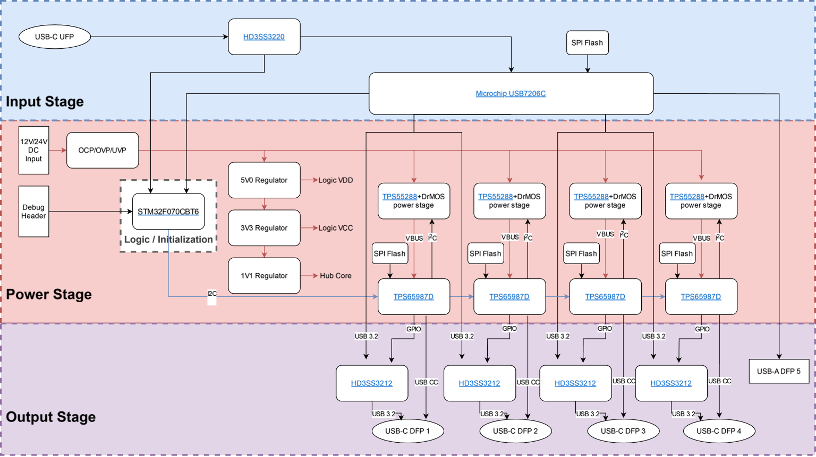
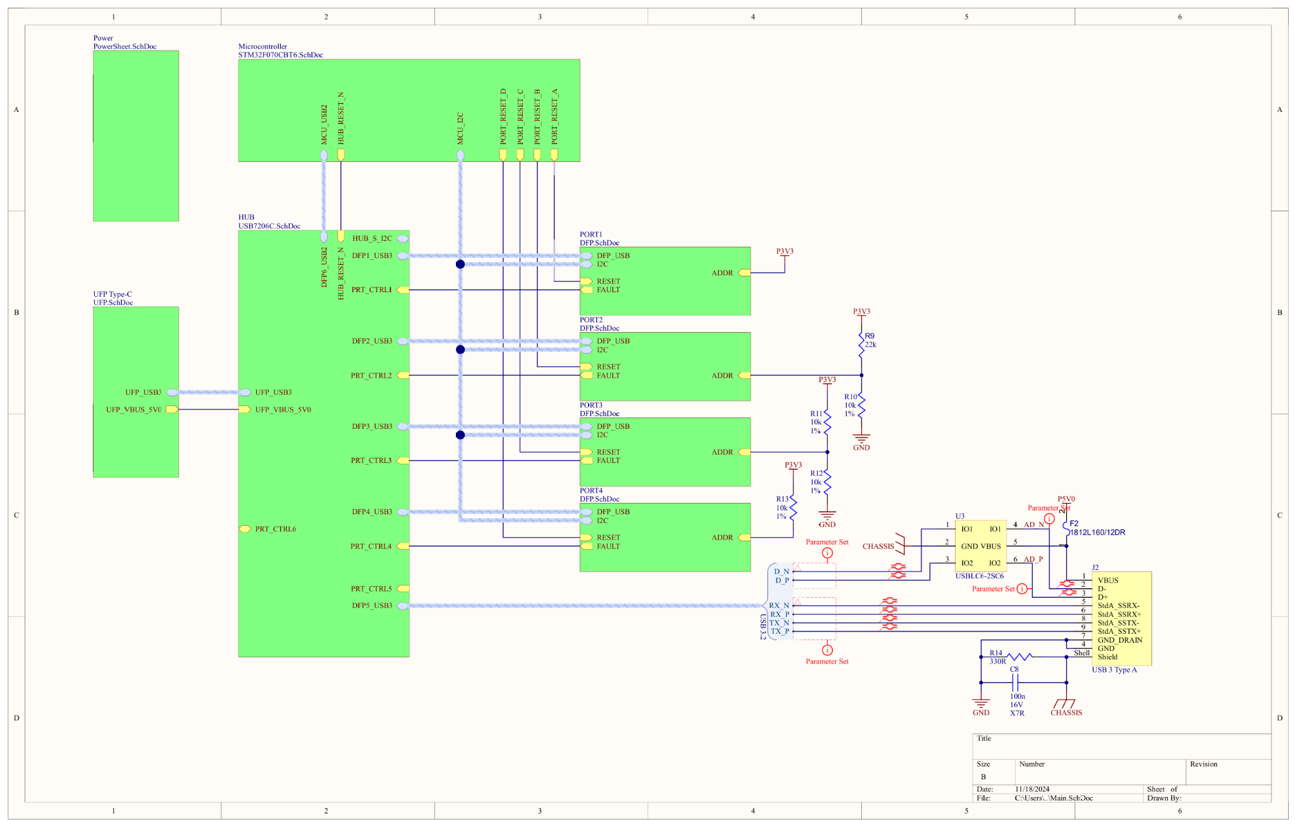
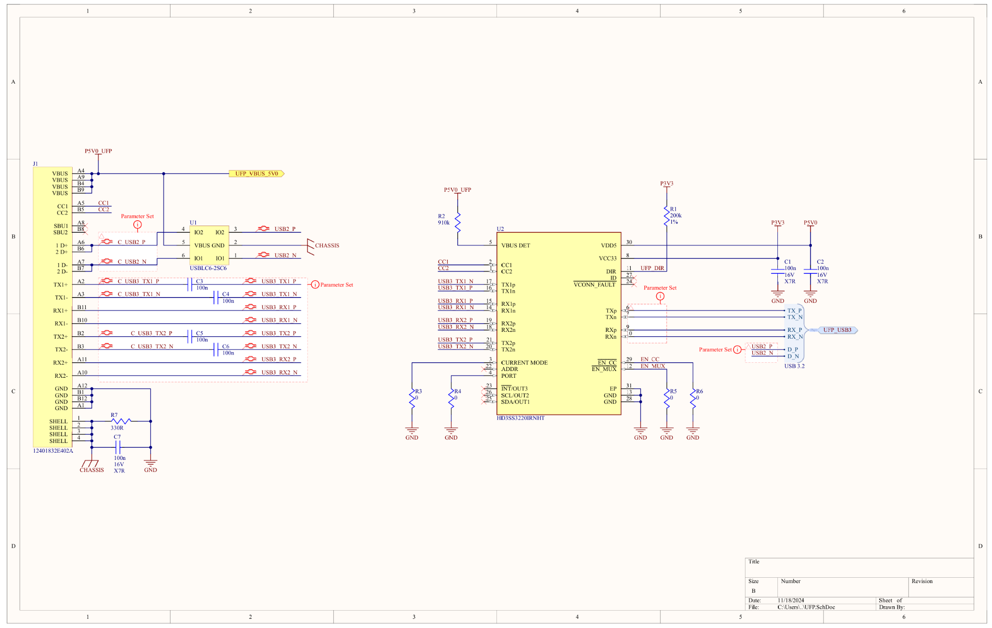
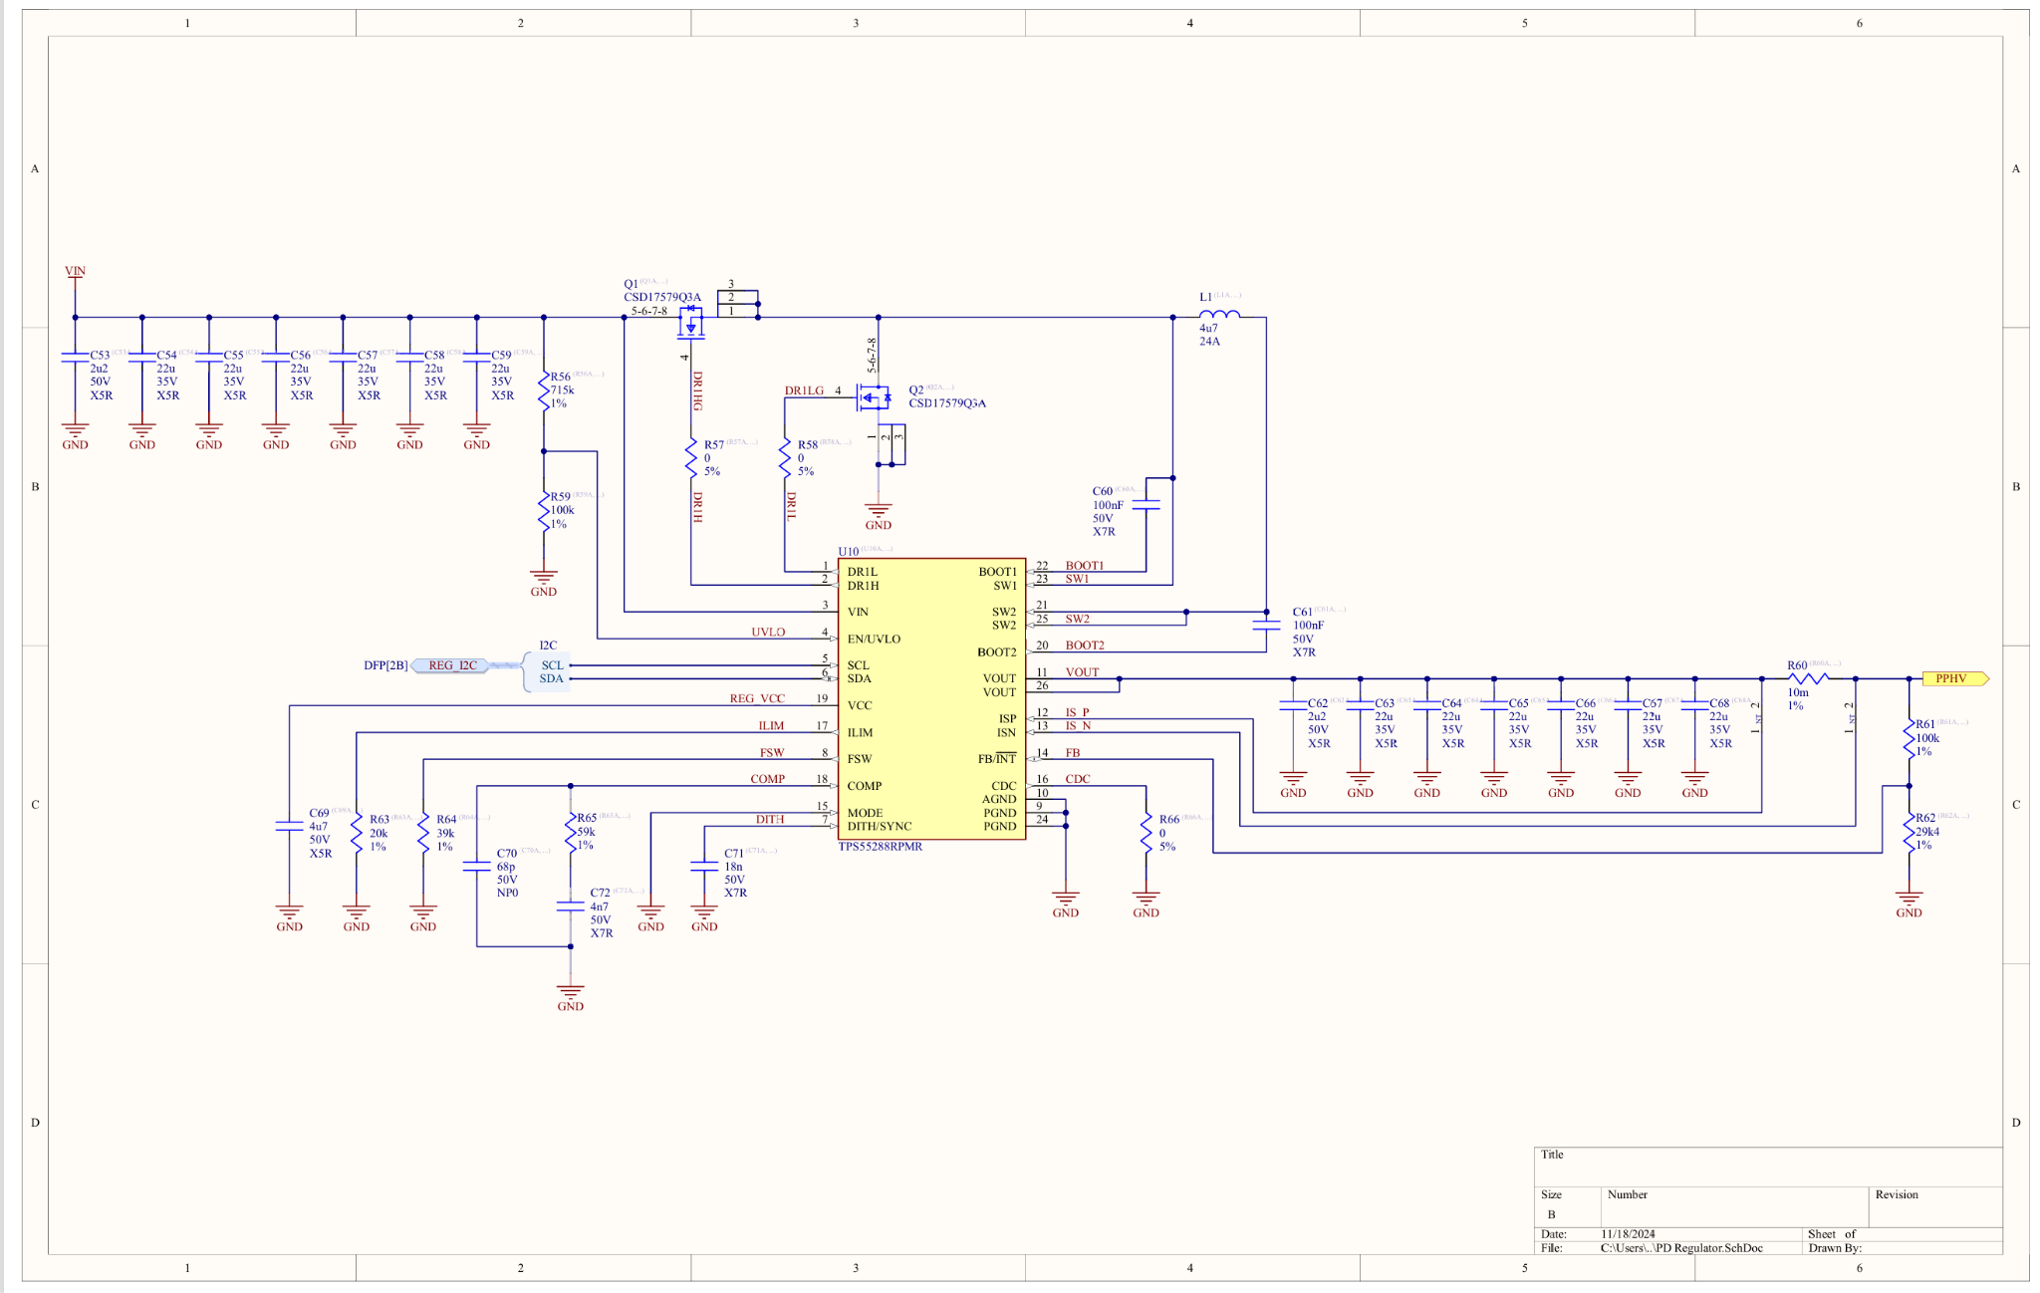
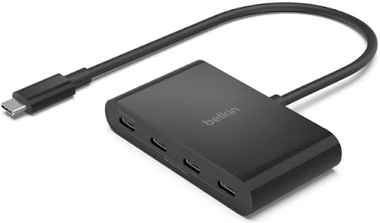
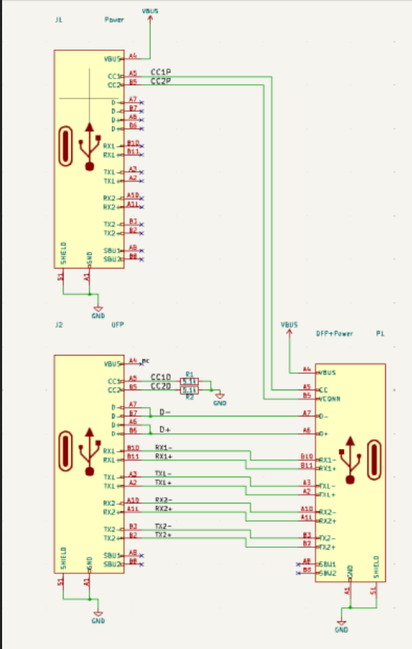
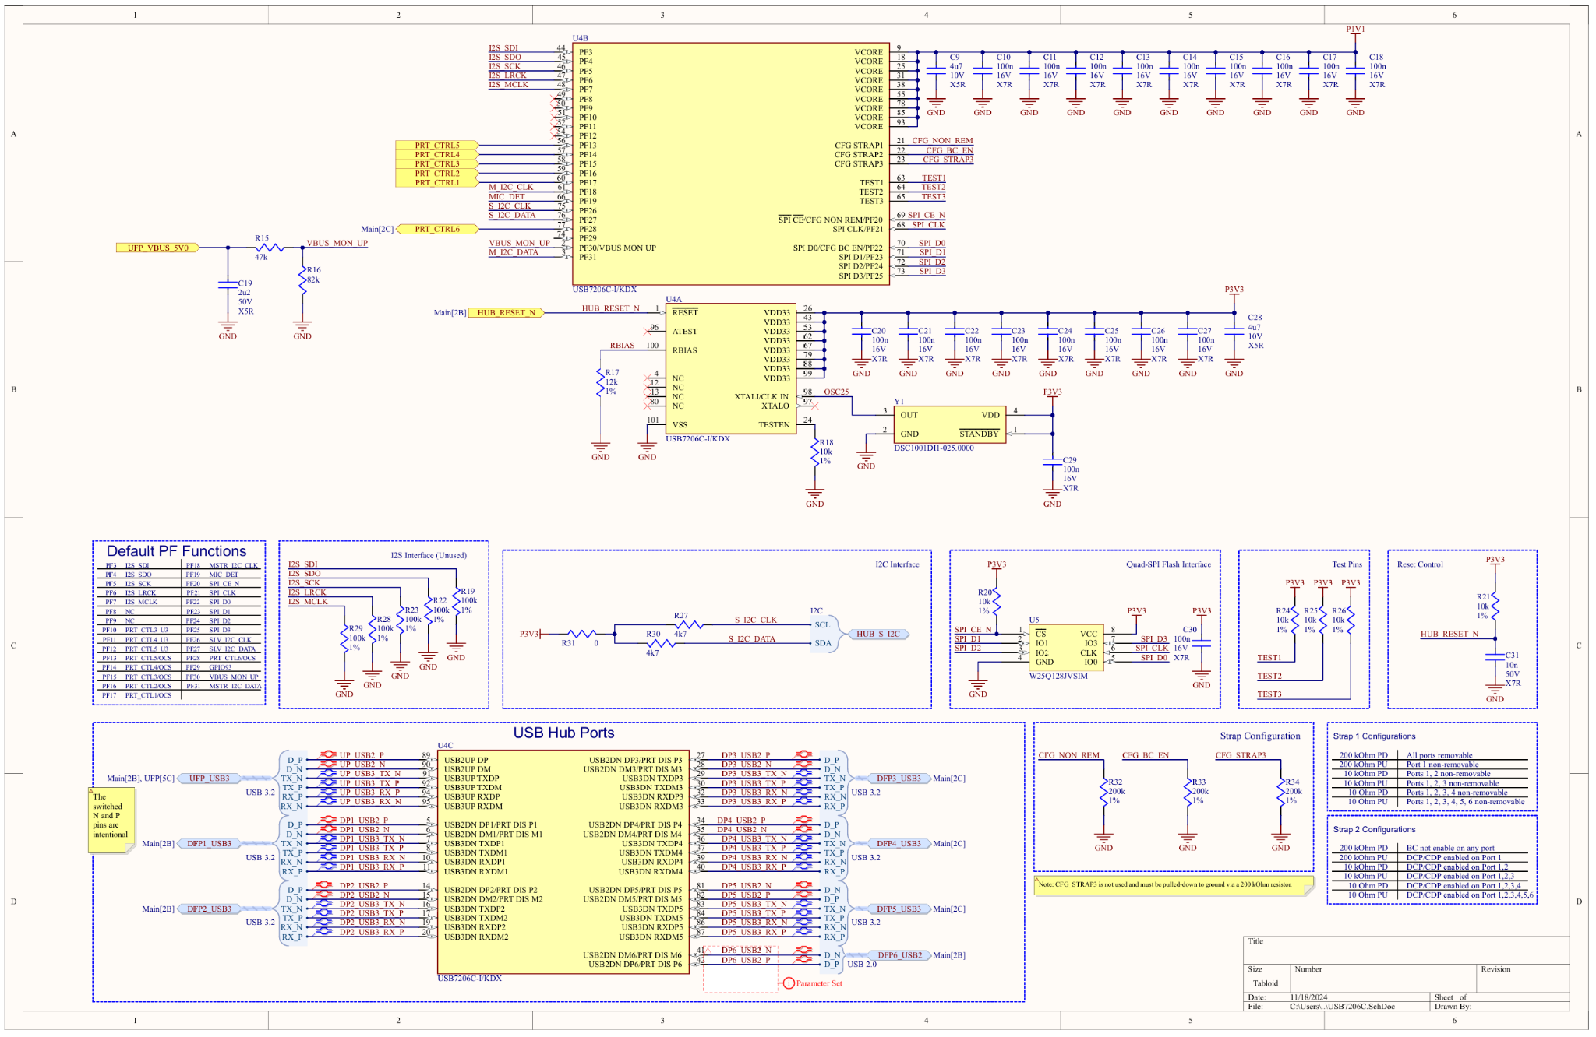
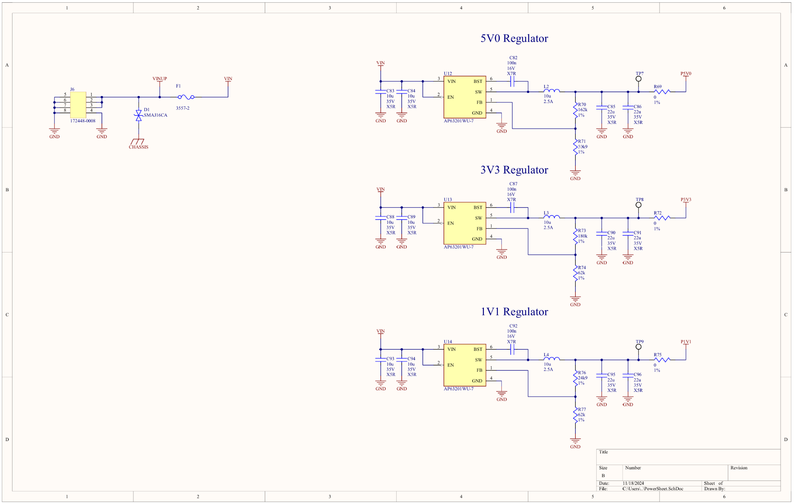
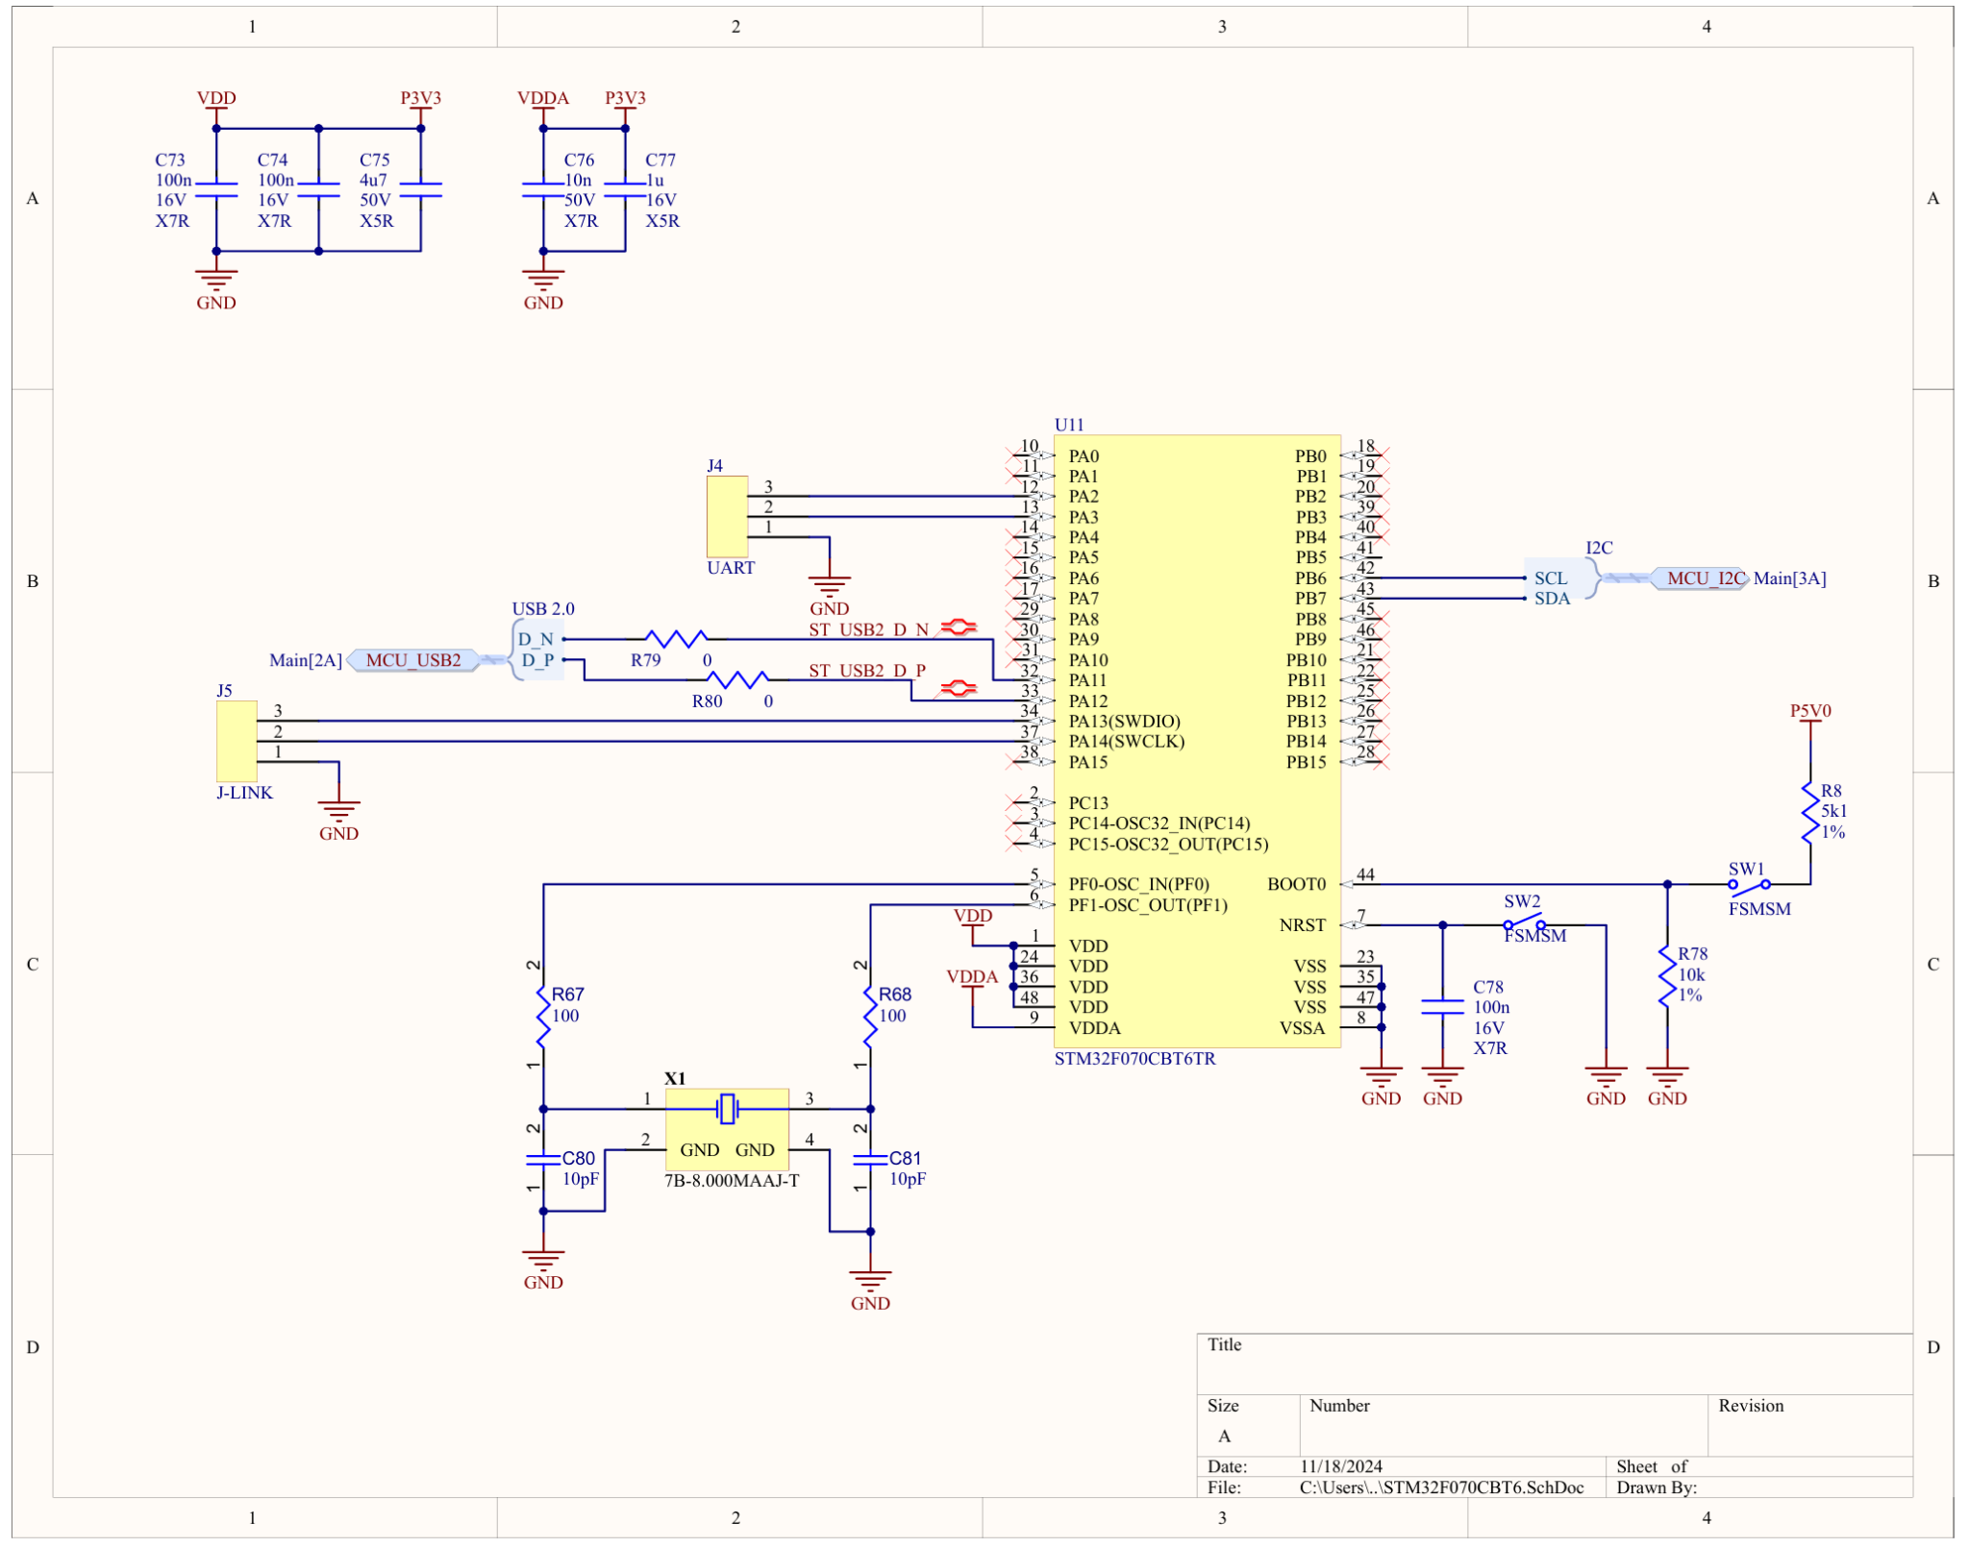
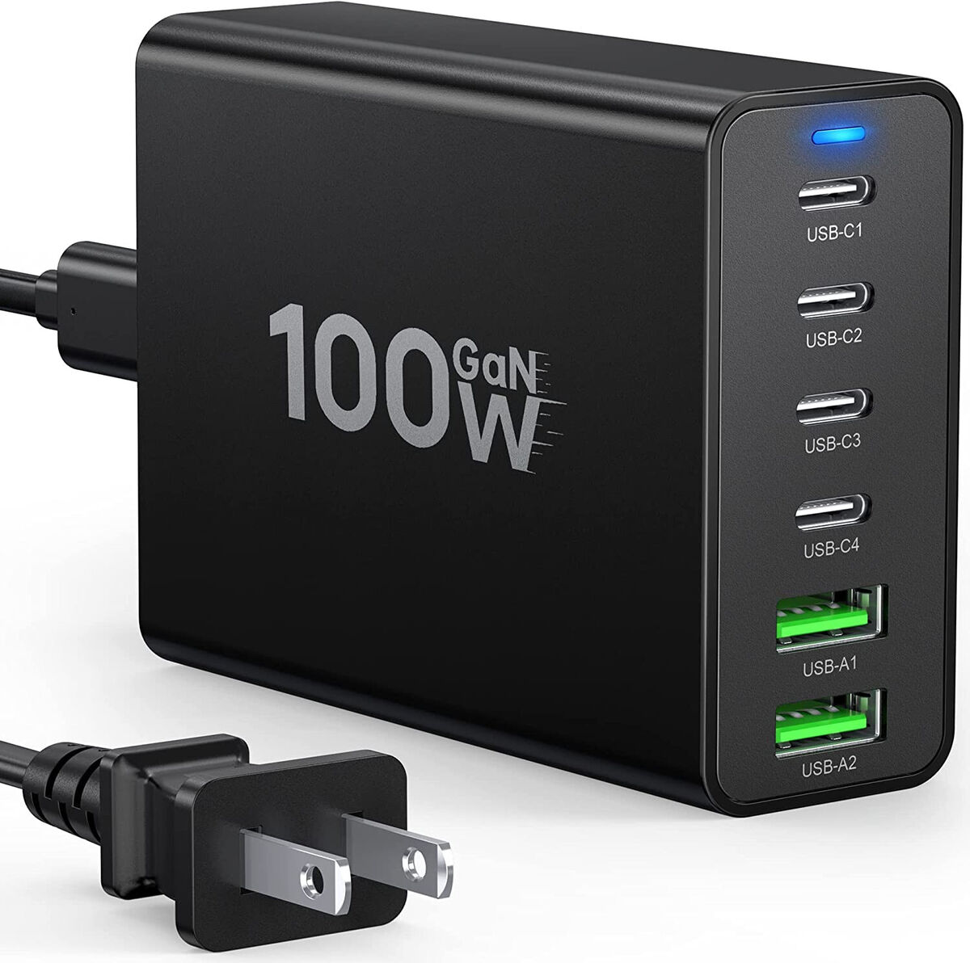
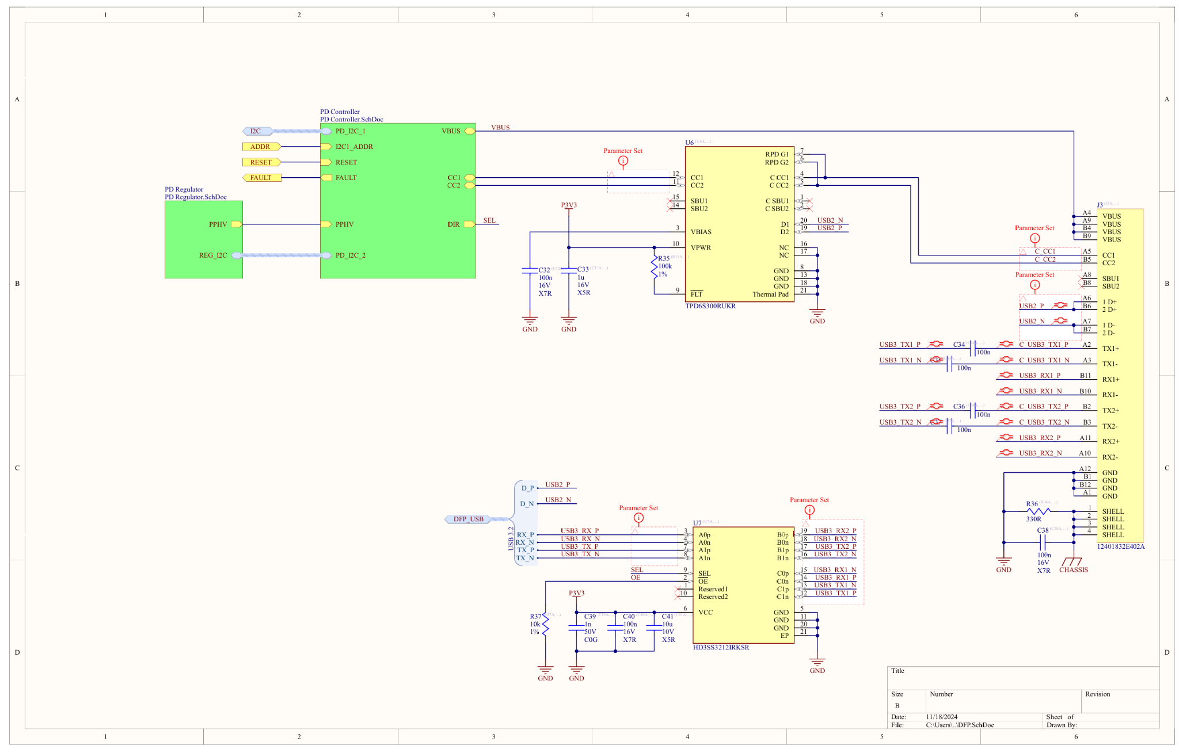
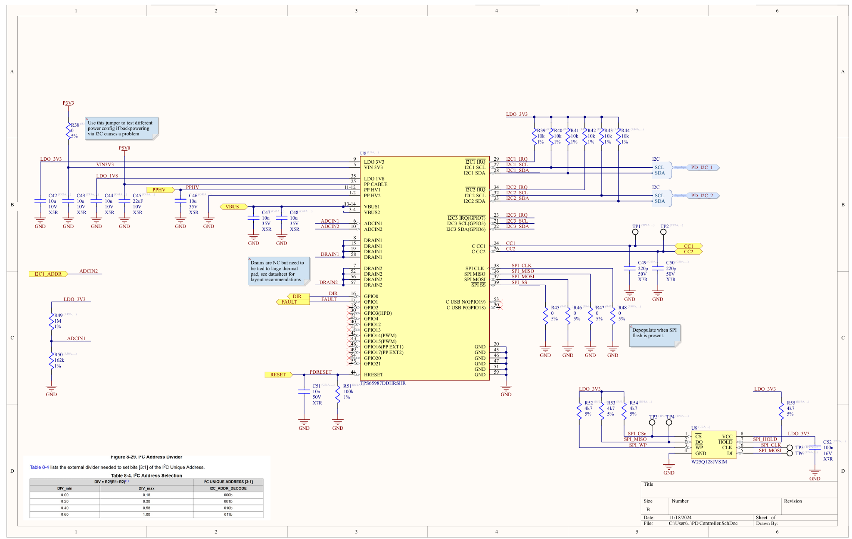
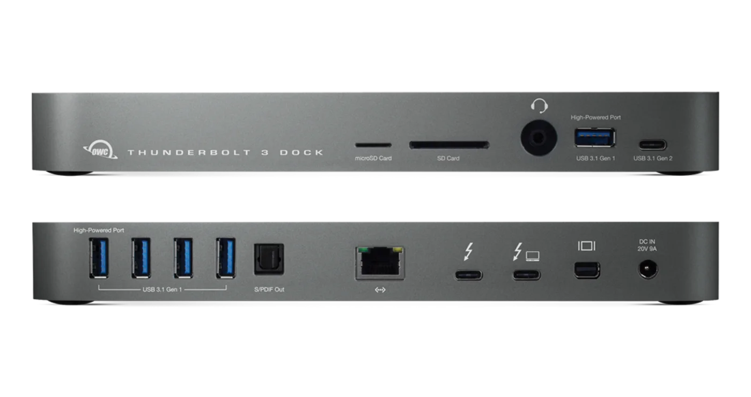
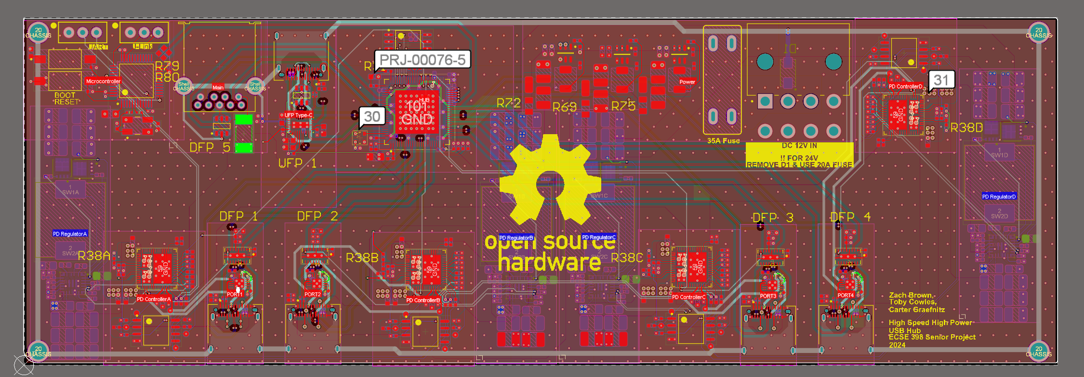
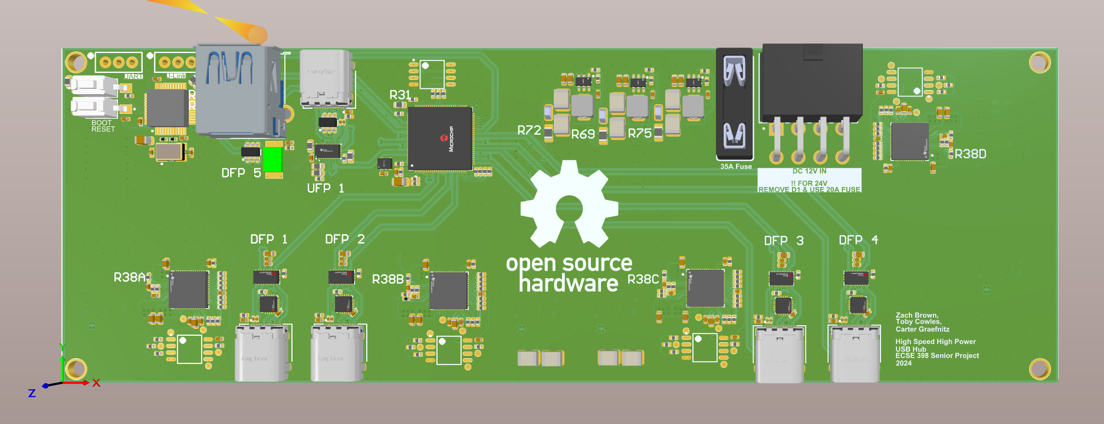
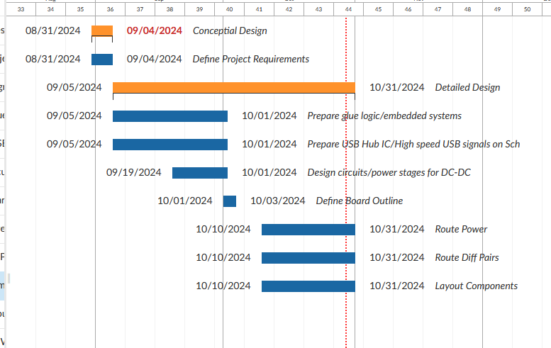
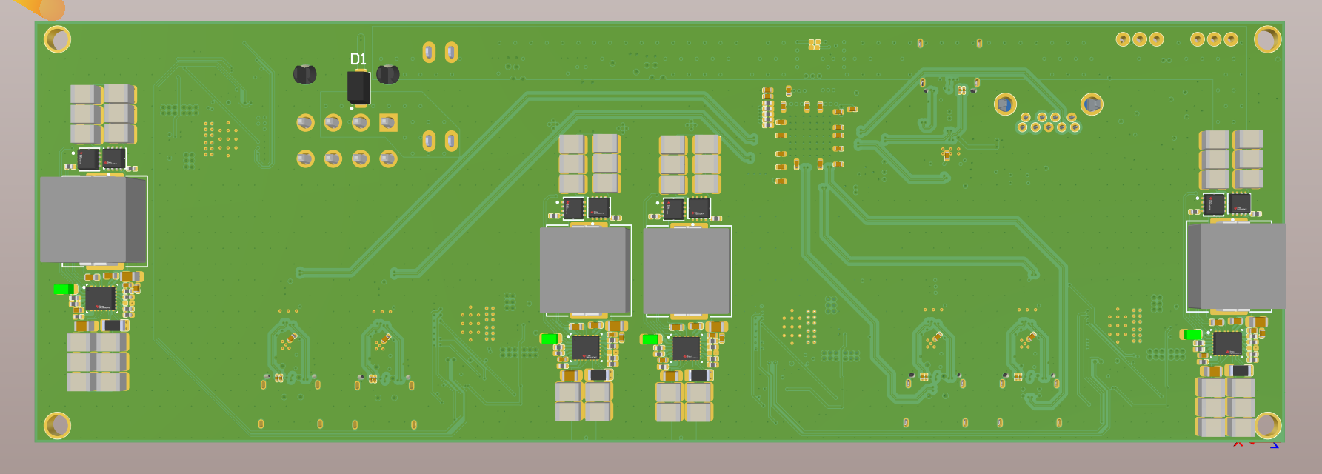
High Speed High Power USB C PD Hub
Zach Brown (EE) Toby Cowles (EE,CE) Carter Graefnitz (EE)
Instructor/Advisor Dr.Gregory Lee, PhD, (ECSE Case Western Reverse University)
Problem, Background & Context:
There is not a commercial USB hub available that is capable of supplying high power USB C PD and high speed data (10Gb/s+) on the same hub. Therefore we propose the design and manufacture of such a hub.
Similar existing solutions are all flawed : Commercial Solutions
-USB C Hubs (no power)
-USB PD adapters (no data)
-Thunderbolt Docks
(bulky, expensive, unneeded features, limited ports)
Existing Projects
https://github.com/Jana-Marie/PD-Injector (Clunky, violates USB Spec, but provided assurance that something like this could be done)
System Architecture & Tech Constraints:
Limited IC selection. There are few 10gb/s USB hub ICs on the market and none faster Making custom ICs/working with non-public ICs is out of scope of this project so we will be constrained by what is available.
Routing traces and manufacturing boards for high frequency data gets more difficult the higher the data speed, which could limit the CMs we can work with as well as impose limits on the design tools required.
Troubleshooting data lines may be difficult given that it would require an oscilloscope fast enough to keep up with a 10 Gb/s data speed.
Schematic Capture:
Belkin.com
Jana Marie (github.com)
Schematic Capture was completed in Altium Designer. We used a multi-sheet layout and sheet symbols to make the project efficient
OWC.com
Amazon.com
PCB Layout:
Project Management:
Manufacturing:
Results and Verification:
Standards/References:
FCC Radio Devices Rule on Homebuilt Devices, 47 C.F.R § 15.23, 2021. [Online] Available: https://ecfr.federalregister.gov/current/title-47/chapter-I/subchapter-A/part-15. Accessed May 12, 2021.
Universal Serial Bus 3.2 Revision 1.1 Specification, USB-IF, USB 3.0 Promoter Group, June 2022. [Online]. Available: https://usb.org/document-library/usb-32-revision-11-june-2022
USB Power Delivery Specification Revision 3.2, Version 1.0, USB-IF, Oct. 2023. [Online]. Available: https://usb.org/document-library/usb-power-delivery
USB Type-C Cable and Connector Specification Release 2.3, USB-IF, Oct. 2023. [Online]. Available: https://usb.org/document-library/usb-type-cr-cable-and-connector-specification-release-23
I²C-bus specification and user manual, UM10204, NXP Semiconductors, Oct. 2021. [Online]. Available: https://www.nxp.com/docs/en/user-guide/UM10204.pdf
IPC, IPC-2141: Controlled Impedance Circuit Boards and High Speed Logic Design (IPC-2141A), Revision A. IPC, 2004.
Relevant Courses:
Acknowledgements:
We designed our board with manufacturability in mind. Early on in the design process we identified our target CM [contract manufacturer] as JLC PCB. We chose JLC due to their extensive part library, competitive capabilities, fast turn times and low prices. We defined our board layer stack based on the JLC0616H-7628 stack up to meet our impedance requirements. All our parts included the JLC part number for ease of ordering.
In order to verify our board we ran DRC on the design. DRC identified 95 possible violations. After review it was determined 40 of these violations are nets in the CC class not meeting the defined rules for their target impedance due to space constraints, and should be able to be safely ignored. 25 of these are net antenna violations caused by TI provided footprints, and can also be ignored. The remaining 20 are small annular rings in the Amphenol provided footprints on the USB C connectors and can also be safely waived.
We laid out the board as a 6 layer board. We kept the high-speed signals on the outer layers to prioritize signal integrity and avoid issues with punch through. Each outer layer has a ground plane underneath it. The two inner layers are used for low-speed signals and power.
Course | Description
ENGR 210 | Basic circuit and network theory, use of instrumentation
ECSE 245 | More advanced power circuitry
ECSE 309 | Covers high speed/high frequency signals. Impedance matching
ECSE 344 | More advanced power circuitry
ECSE 371 | Applied circuit design
ECSE 303 | Firmware development
In order to ensure the project was completed on time we used project management strategies to divide and plan out the work including a detailed project plan document and a Gantt Chart. We also did multiple design reviews throughout.
Thank you to Altium for providing student licenses. Thank you to Dr.Lee for being our advisor and his lab for supporting this project financially.
Presented: December 6th, 2024
Copyright © 2024
ECSE 398

